Slide 2
Why INDIAN PROPERTY EXPO?
Biggest platform for networking with the industry leaders
Best platform to showcase your Affordable and Premium projects
Innovative ideas from the people who are the driving force in the industry
Gathering of 2000+ HNI’s, Investors, Buyers & Channel Partners under one roof
Extensive media coverage (print media
& Social Media)
"Don’t Delay, Start Interacting With Your Customers Now"

Slide 3
"UTILIZE A DYNAMIC INDIAN PROPERTY EXPO. TO MAXIMIZE THE LEAD GENERATION FACETS OF OUR EVENT BY TOUCHING THOUSANDS OF
BUSINESS PROSPECTS"

Slide 4
Advantages of Participation
​Reach a Broader and Global Audience to Generate Highest Sales.
Generate Quality Leads and Providing Site Visits for your exclusive Projects.
Engage Customer in innovative way.
Boost and Track Impressions for your exclusive Projects.
Asses the ROI of Event.
A Sluggish Sales from HNI's, Investors, Buyers and Channel Partners.
Advantage of Large number of Sales from 14 Active Broker Association.
Minimal Investment for Big Result.
Get the Full Contact List of Visitors and their Inquiries.
Reduce CPL and Meet Direct client for your Projects.
Much Better than Participating in a Designing Stall and Venue Based Property Exhibition.

Slide 5
About Realty Quarter
REALTY QUARTER is a Real Estate Media with a prime focus to explore the Real Estate Sector, Construction Material Industry, Advertising and Marketing Verticals in India & International. Realty Quarter is one of the most read digital Real Estate portals that syndicates information on Real Estate News, Investments Trends, Property Updates, Research & Surveys, Government Policies, Architects & Engineers, Interior Designers, Lifestyle, Hospitality and Home Improvements.
Also we are Publication, Events and Exhibition Organizing Company too. We have been organizing HNI's and Investor Meet, Property Expo. and Real Estate Awards Nationally (Mumbai, Pune, Ahmedabad, Delhi, Jaipur and Bangalore) as well as International (Dubai, Abu Dhabi, Muscat, Hong Kong, Singapore and London).

Slide 6
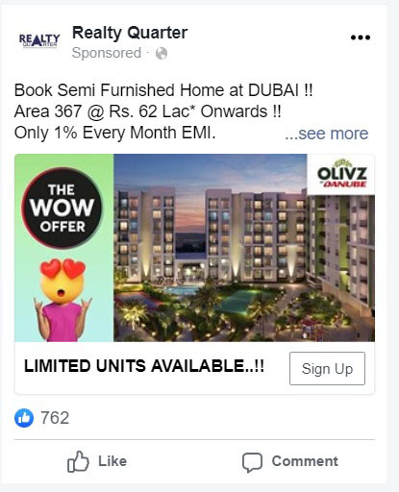
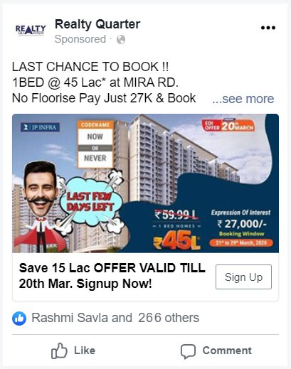
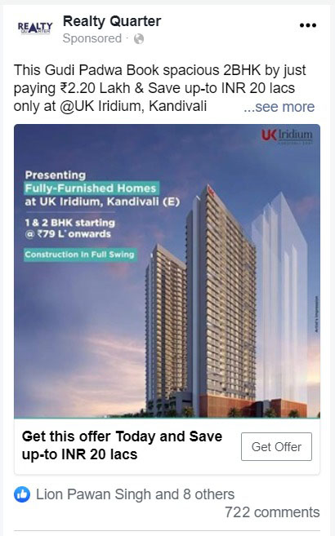
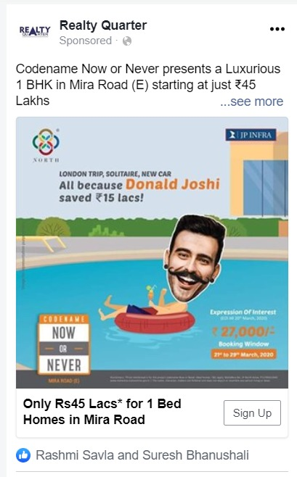
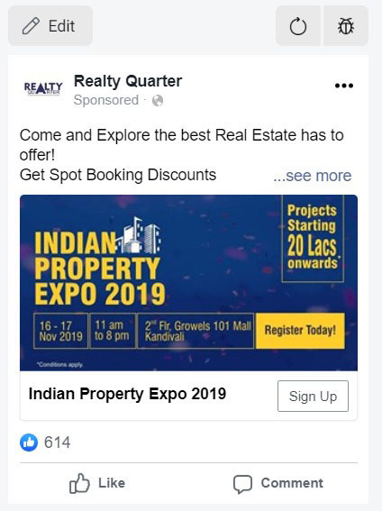
Past Show Glimpses (Digital Campaign)

Slide 7
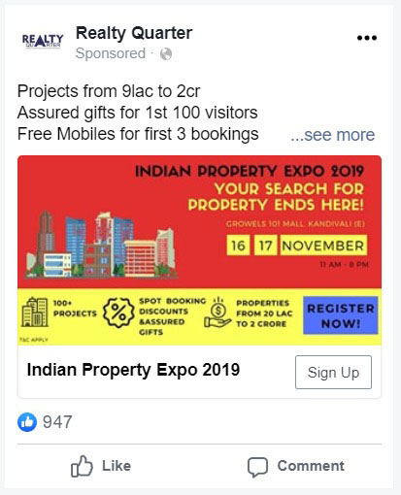
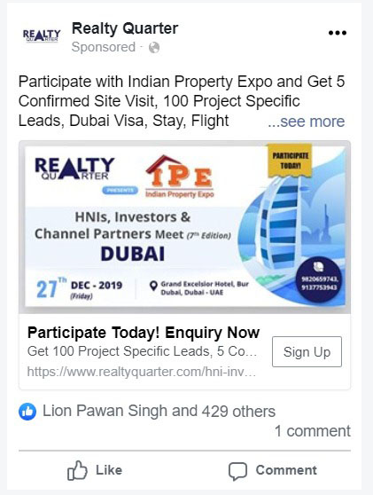
Past Show Glimpses (Digital Campaign)

Slide 8
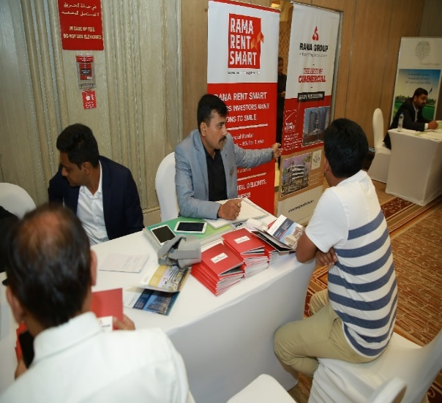
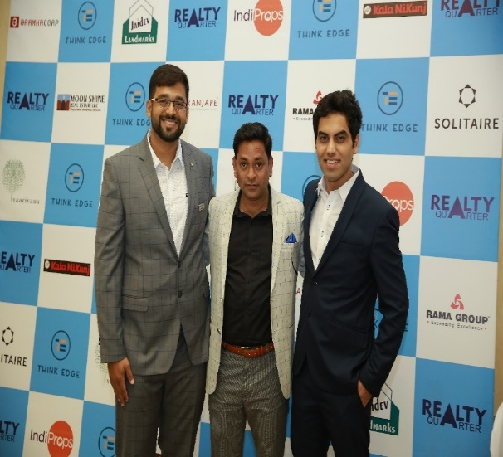
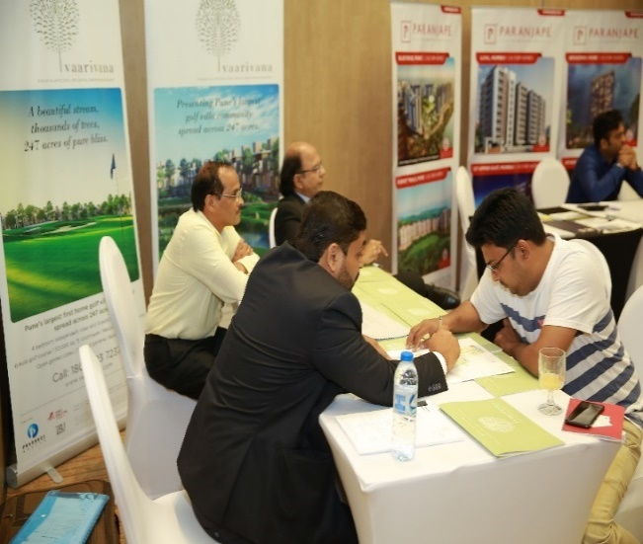
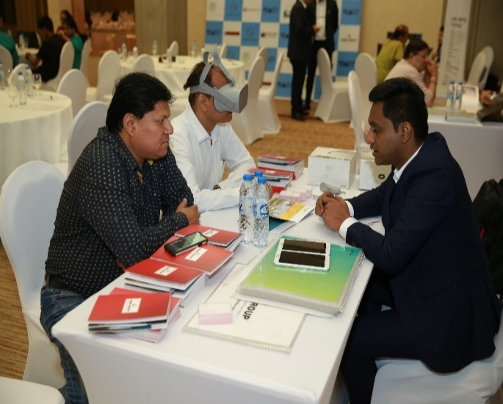
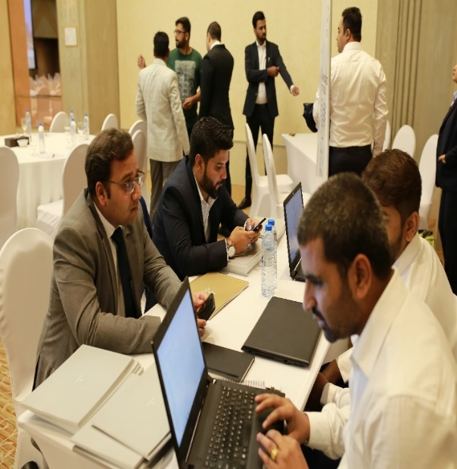
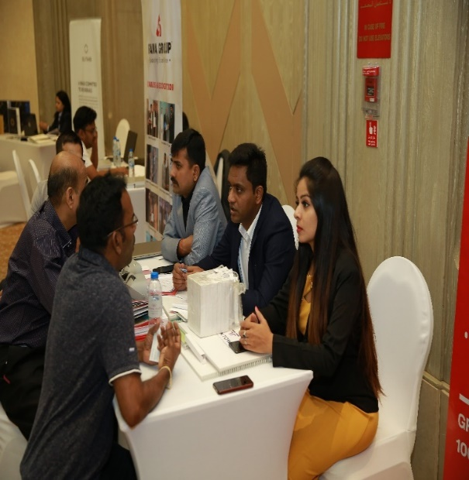
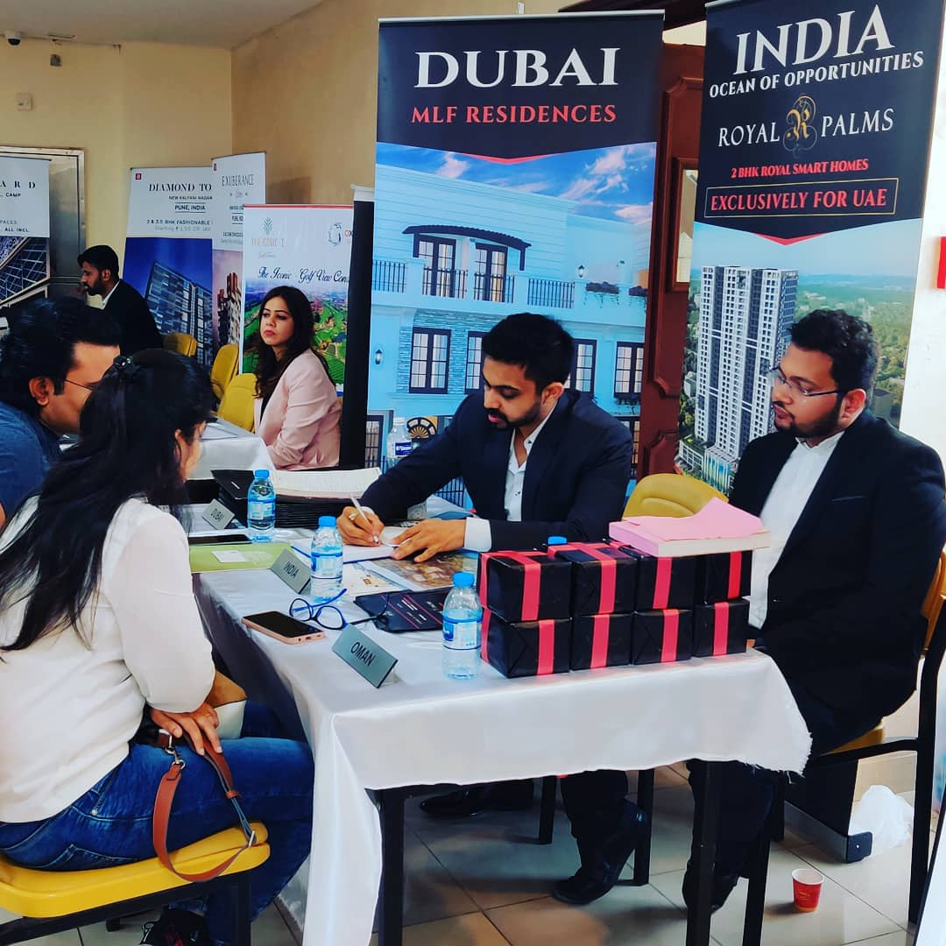
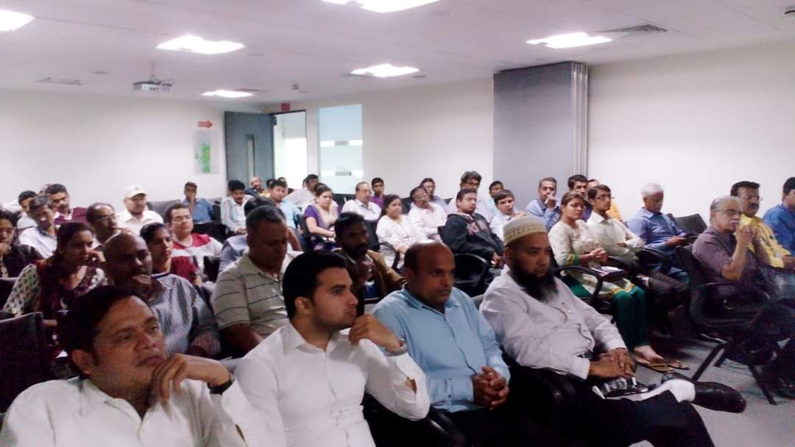
Past Show Glimpses

Slide 9
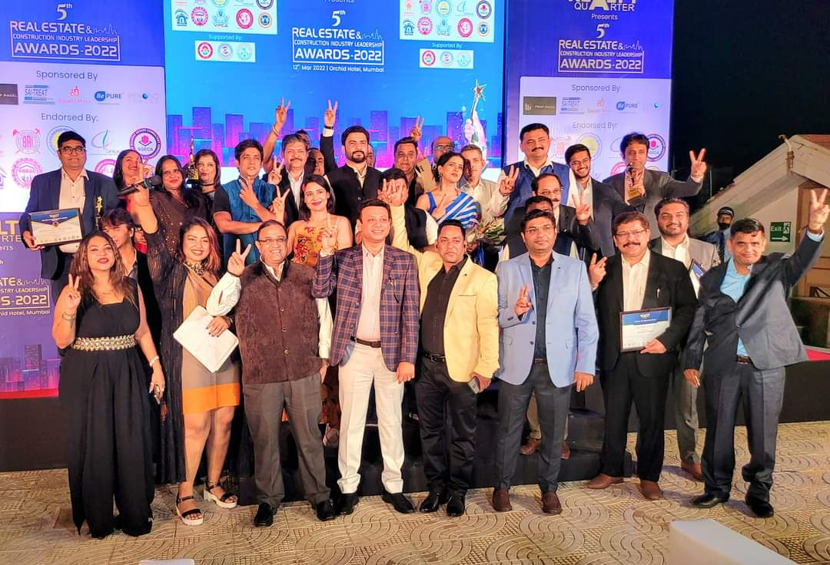
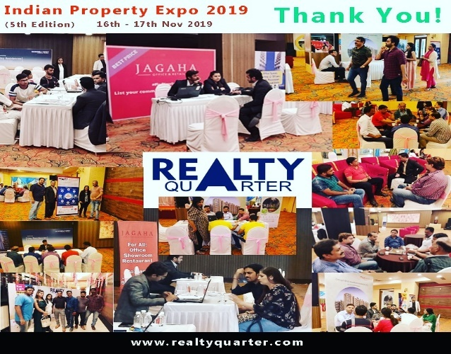
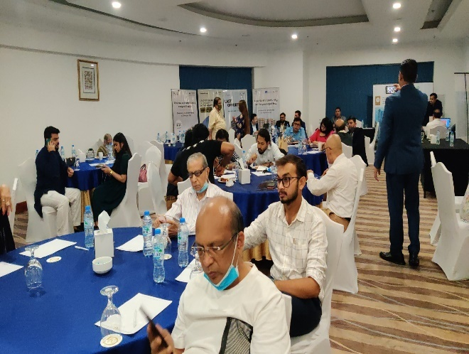
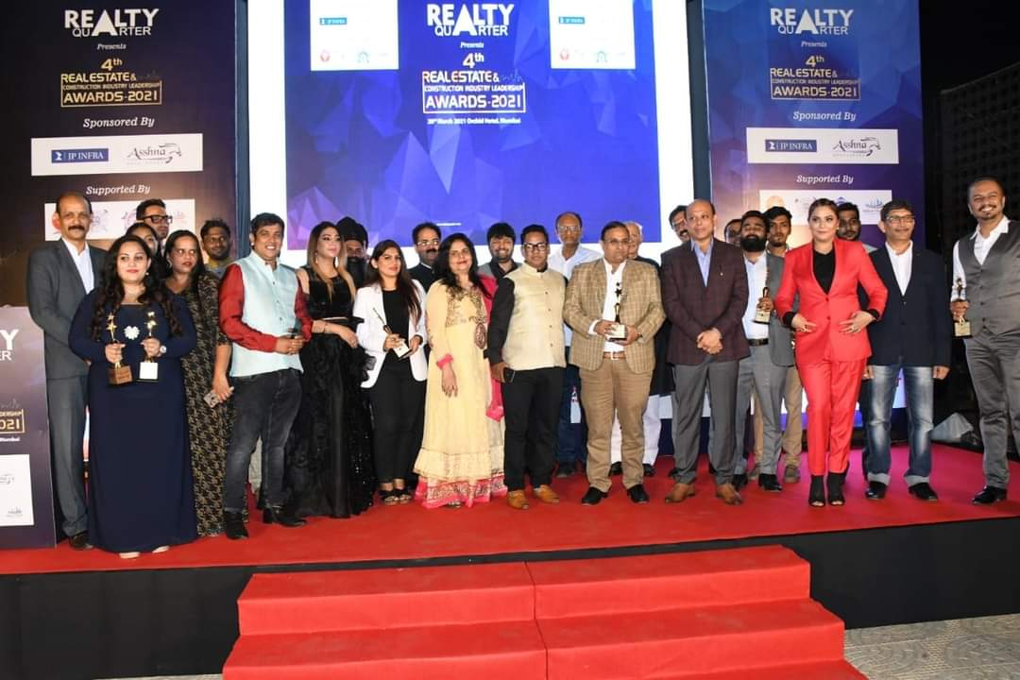
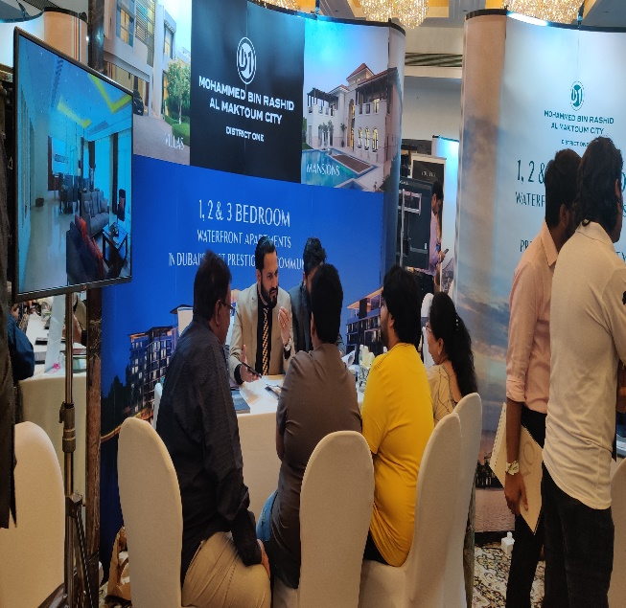
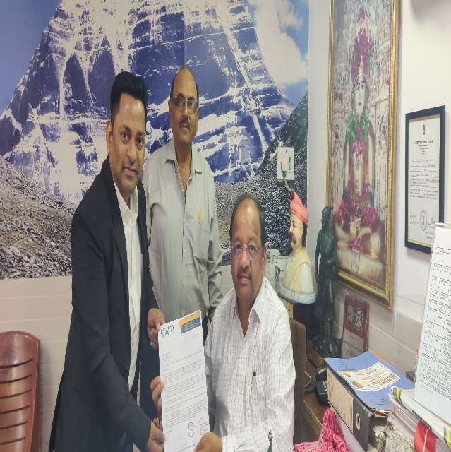
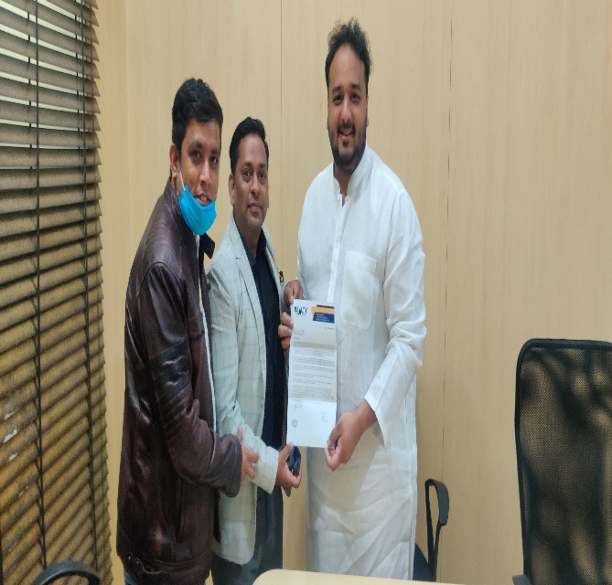
Past Show Glimpses

Slide 10
Standard Participation Benefits & Price
Exclusive Business Space at Exhibition Area. Size (4 Feet X 2.6 Feet) for Two Days
Branding Space Maximum 2 Standees Only/-
Brand and Project Promotion on our Online Indian Property Expo. & Realty Quarter Web page.
Extensive Logo Coverage with Tagline in our all Marketing Collaterals.
Company Logo and Project details on Realty Quarter and Indian Property Expo. for 3 Months Only
Data of Unique Buyers, Investors and Channel Partners Approx. 2000+
PARTICIPATION PRICE FOR ALL ABOVE BENEFITS IS RS. 50,000/- PLUS TAXES

Slide 11
Premium Participation Benefits & Price
Exclusive Business Space at Exhibition Area. (4 Feet X 2.6 Feet) for Two Days.
Branding Space Maximum 2 Standees.
Guaranteed 25 Project Specific Leads for your Projects. (Leads will be Sharing after the Exhibition).
Guaranteed 2 Site Visits for your Projects. (Within 15 Days after the end of our Exhibition).
Brand and Project Promotion on our Online Indian Property Expo. & Realty Quarter Web page.
Extensive Logo Coverage with Tagline in our all Marketing Collaterals.
Company Logo and Project details on Realty Quarter and Indian Property Expo. for 6 Months Only.
Data of Unique Buyers, Investors and Channel Partners Approx. 2000+
PARTICIPATION PRICE FOR ALL ABOVE BENEFITS IS RS. 75,000/- PLUS TAXES

Slide 12
Value – Added Participation Benefits & Price
Exclusive Business Space at Exhibition Area. (8 Feet X 2.6 Feet) for Two Days.
Branding Space Maximum 3 Standees.
Backdrop Size (6 Feet X 6 Feet) at your exclusive Business Space.
Guaranteed 50 Project Specific Leads Generating for your Projects. (Leads will be Sharing after the Exhibition).
Guaranteed 5 Site Visits for your Projects. (Within 15 Days after the end of our Exhibition).
Running Project Video on Projector Screen Continuously for Visibility of your all Projects.
Brand and Project Promotion on our Online Indian Property Expo. & Realty Quarter Web page.
Extensive Logo Coverage with Tagline in our all Marketing Collaterals.
Company Logo and Project details on Realty Quarter and Indian Property Expo. for 1 year Only.
Data of Unique Buyers, Investors and Channel Partners Approx. 2000+
PARTICIPATION PRICE FOR ALL ABOVE BENEFITS IS RS. 1,50,000/- PLUS TAXES

Slide 13
MEDIA PLAN FOR INDIAN PROPERT EXPO. 2022
Advertisement in Local leading newspaper like Times of India, Mumbai Mirror, DNA and Hindustan Times.
Radio Promotion on Reliance 92.7 BIG FM (Pre before 2 Day’s and Post After event).
Exclusive Project Marketing through various social media platform like M Indicator, You Tube and MNC’s Website.
Social Media Promotion on Facebook, LinkedIn, Twitter and Instagram (Pre before one week and Post)
Email and SMS campaign on our Exclusive data base which is approx. 5 Lacs.
Paper Insertion and Kiosk on nearest railway Station before 3 days of the event.
Outdoor Hoarding before 3 Days of Indian Property Expo. In all visible area of WEH.
Private Invitation to all 14 active Broker Association as a Real Estate Media.
Private Invitation to all club members like Lions Club, Country Club, Mahindra Club, Otters Club, Carter Club and Raheja Club.
Indian Property Expo. Promotion through High End Societies, Cycle Rikshaw, Best Buses and Nearby
Railway Station.

Slide 14
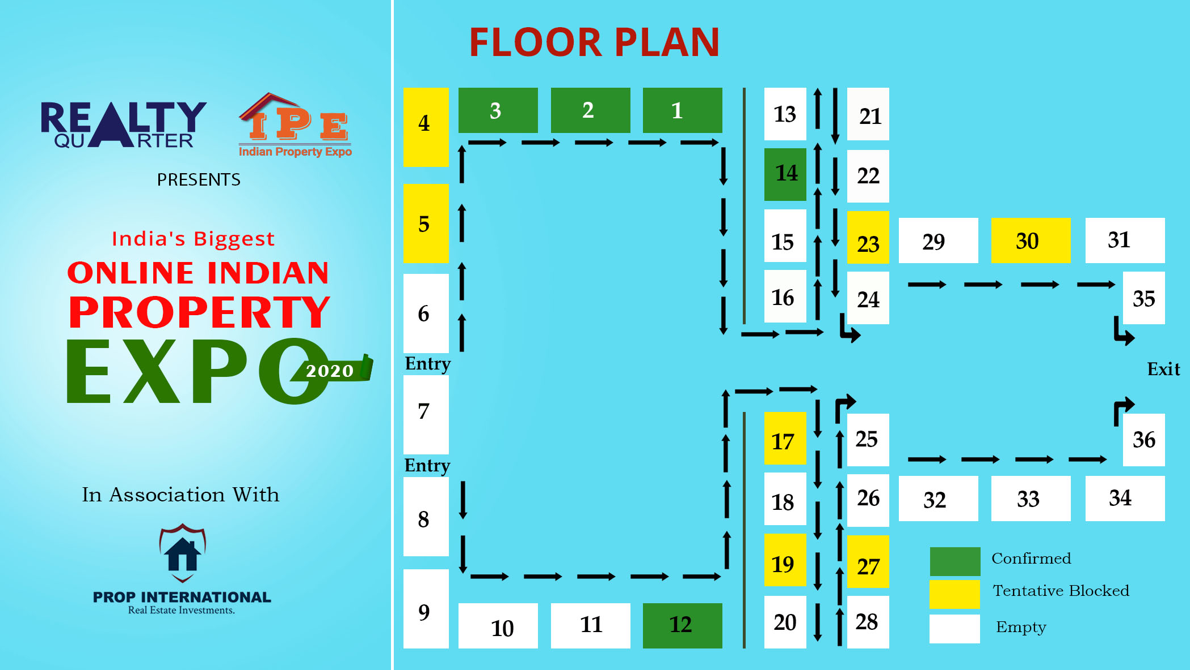
Floor plan

Slide 15
Our Esteem Clients

Slide 16
Contact Us for Participation
Pawan Chauhan
+ 91-9820659743 / + 91-9970037166
marketing@realtyquarter.com
Shaista Ansari
+91-8279547396
shaista@realtyquarter.com
Ayushi Sharma
+91-9833126134
sales@realtyquarter.com
Bipin Pandey
+91- 9082455259
sales@realtyquarter.com
For More Information and Details kindly visit our website www.realtyquarter.com

Slide 17
THANK YOU !!

